Slide 1

WVD WORK FLOW

Slide 2
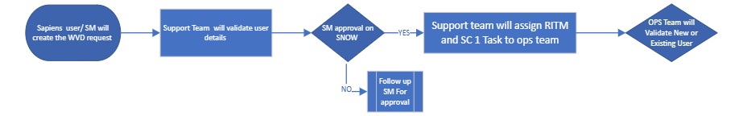
Service Manger Approval Phase

Slide 3
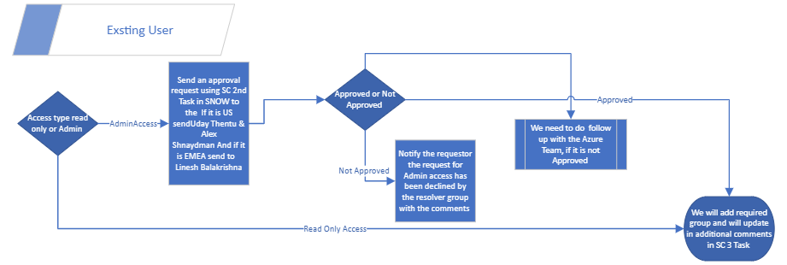
Exiting User Modification Flow

Slide 4
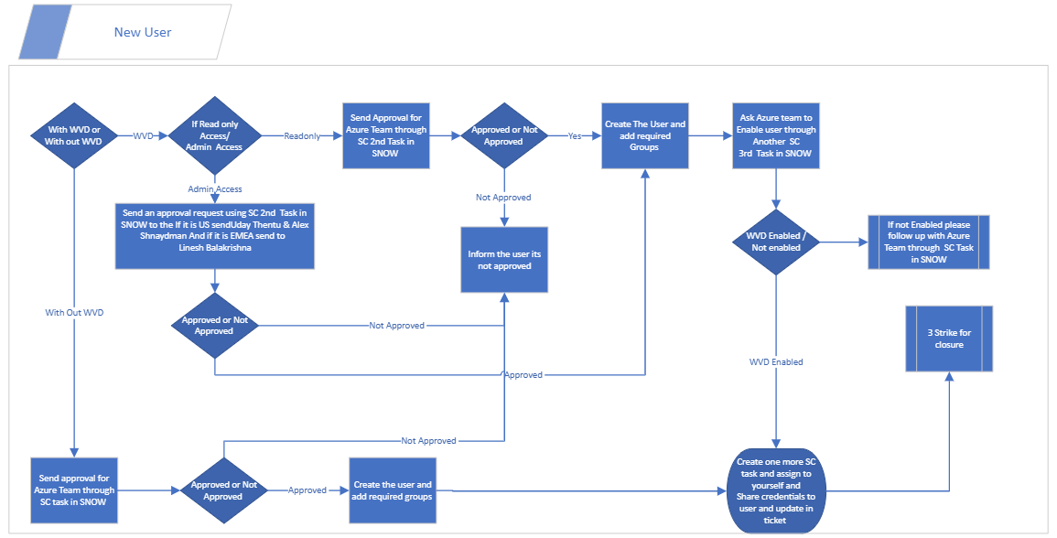
New User creation Work Flow
Note : This is for Single WVD User Creation Via WVD Catalogue

